Slide 1

Security Improvement of Cloud Data using hybrid Cryptography & Steganography
by
G. Ajay Kishore
Roll No. 204G1A0506
M. Mounika
Roll No. 204G1A0561
T. Harsha Sri
Roll No. 204G1A0536
B. Bhavana
Roll No. 204G1A0522
Under the guidance of
Mr. M. Narasimhulu M.Tech (Ph.D)
Assistant Professor
Department of Computer Science and Engineering
Srinivasa Ramanujan Institute of Technology
(Autonomous)
2023 - 2024

Slide 2

Contents
Abstract
Problem statement
Objectives of Project
Literature survey for first objective
Literature survey for second objective
Proposed Work
References
GitHub Link
Queries

Slide 3
Abstract
In Today's world , many organizations use cloud environment for storing the data. As cloud technology becomes popular, data security is a big concern. To fix this issue, here we are securing cloud data by using Hybrid Cryptography, Steganography, Information Concealment, and Hashing Functions.
In this system, we perform data encryption through combining Asymmetric and Symmetric Algorithms. To optimize storage and enhance the security layers, we introduce a compression Algorithm immediately after the initial encryption phase. The compressed data will be hidden in an image using steganography algorithms. Finally we use hashing algorithm for validation purpose.
Keywords: Encryption, Information Concealment, Hashing.

Slide 4
Problem Statement
The increase in data breaches in cloud computing puts all users at risk of
business problems, highlighting the need to improve security measures.
To mitigate the growing risks of data threats faced by users in cloud
Environment, proactive measures are essential.

Slide 5
Objectives of Project
To Implement a Hybrid Encryption scheme to enhance Data security and minimize the risk of hacking.
Enhancing data security with the help of Steganography, Storing data in multimedia formats like Images, Audio, and Video adds another level of complexity for potential attackers, making it even harder to compromise data security.

Slide 6
Literature survey for first objective
In this paper, The method employs a public auditing scheme for cloud data storage security while preserving the privacy of the user's data. The effectiveness of the auditing procedure is increased by using encryption and the SHA hash method to ensure that the Third Party Access cannot access the outsourced data on the cloud server while performing integrity checks.The Strength of the paper is that it boost the outsourced approach for checking data integrity. Utilizing methods of cryptography, the implicit Issue with cloud security has been fixed. The Drawback is that RSA’s encryption and decryption processes take longer[1].

Slide 7
Literature survey for second objective
In this paper[2], The data is categorized into three types, based on the user preference . The three Categories are Not Sensitive data, Sensitive data and Trusted Provider, Sensitive data and non-Trusted Provider. For the second category, The cloud service provider is responsible to establish the security of Data using DES algorithm. For the third category, both user and CSP are responsible for ensuring Data security using AES algorithm before sending to CSP but It utilizes a single hashing method and cryptographic technique.

Slide 8
Proposed System
This proposed system encrypts secret data in a hybrid way using the symmetric encryption algorithm and the asymmetric encryption algorithm.
The Encrypted data is compressed and sent to the steganography algorithm to be hidden.
Hash Functions are used without the need for a third party to confirm the validation of the data quickly after retrieval.

Slide 9
References
[1]. Sarah Shaikh, Deepali Vora, “Secure cloud auditing over encrypted data”,
2016 International Conference on Communication and Electronics Systems
(ICCES)
[2]. Richa Singla, Richa Dutta, “Hybrid Algorithm for Cloud Data Security”,
International Journal of IT & Knowledge Management (IJITKM), Volume-
10, Number-2 Jan-June 2017.
[3]. Ashraf A.M.Khalaf, Osama Fouad Abdel Wahab, “Hiding Data Using
Efficient Combination of RSA Cryptography, and Compression
Steganography Techniques”, IEEE Access(Volume:9) on 18 February 2021.

Slide 10
References
[4]. Ghassan Sabeeh Mahmood, Dong Jun Huang, Baidaa Abdul Rahman
Jaleel, “Achieving an Effective, Confidentiality and Integrity of Data in
Cloud Computing” International Journal of Network Security, Vol.21, No.2,
PP.326-332, Mar. 2019.

Slide 11
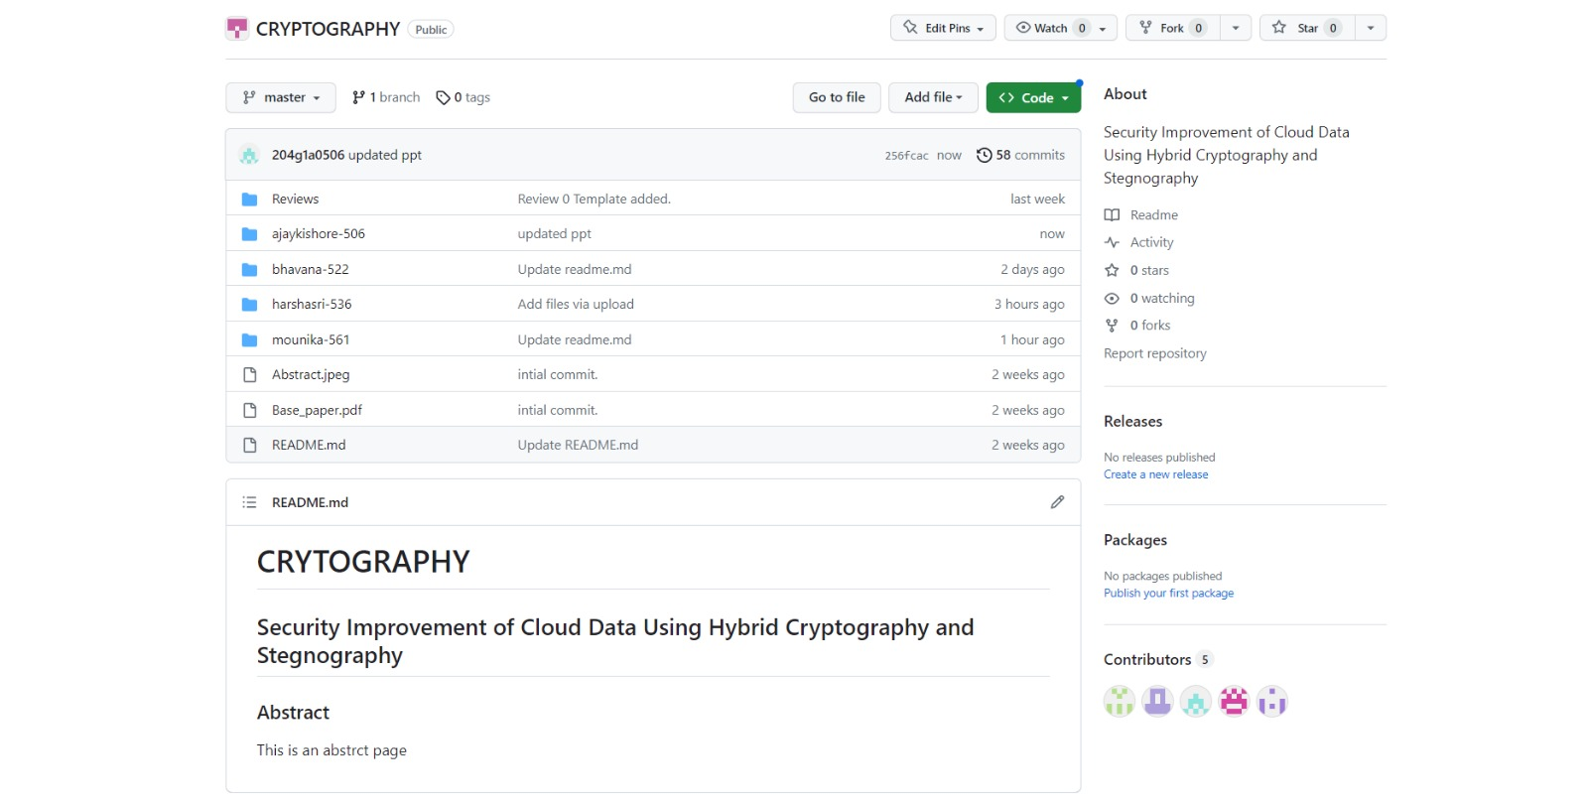
Git Hub Dashboards of each student
https://github.com/SRIT-CSE/CRYPTOGRAPHY.git

Slide 12
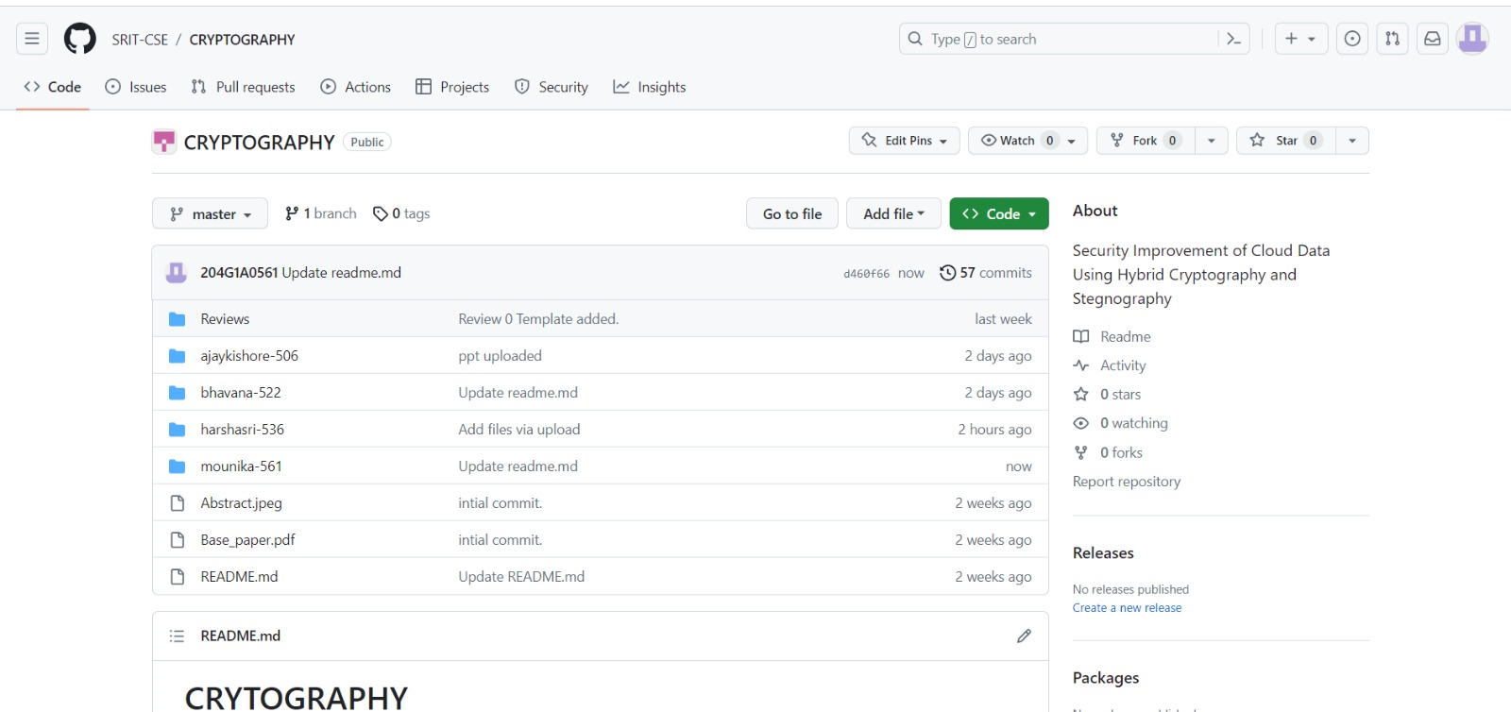
Git Hub Dashboards of each student
https://github.com/SRIT-CSE/CRYPTOGRAPHY.git

Slide 13
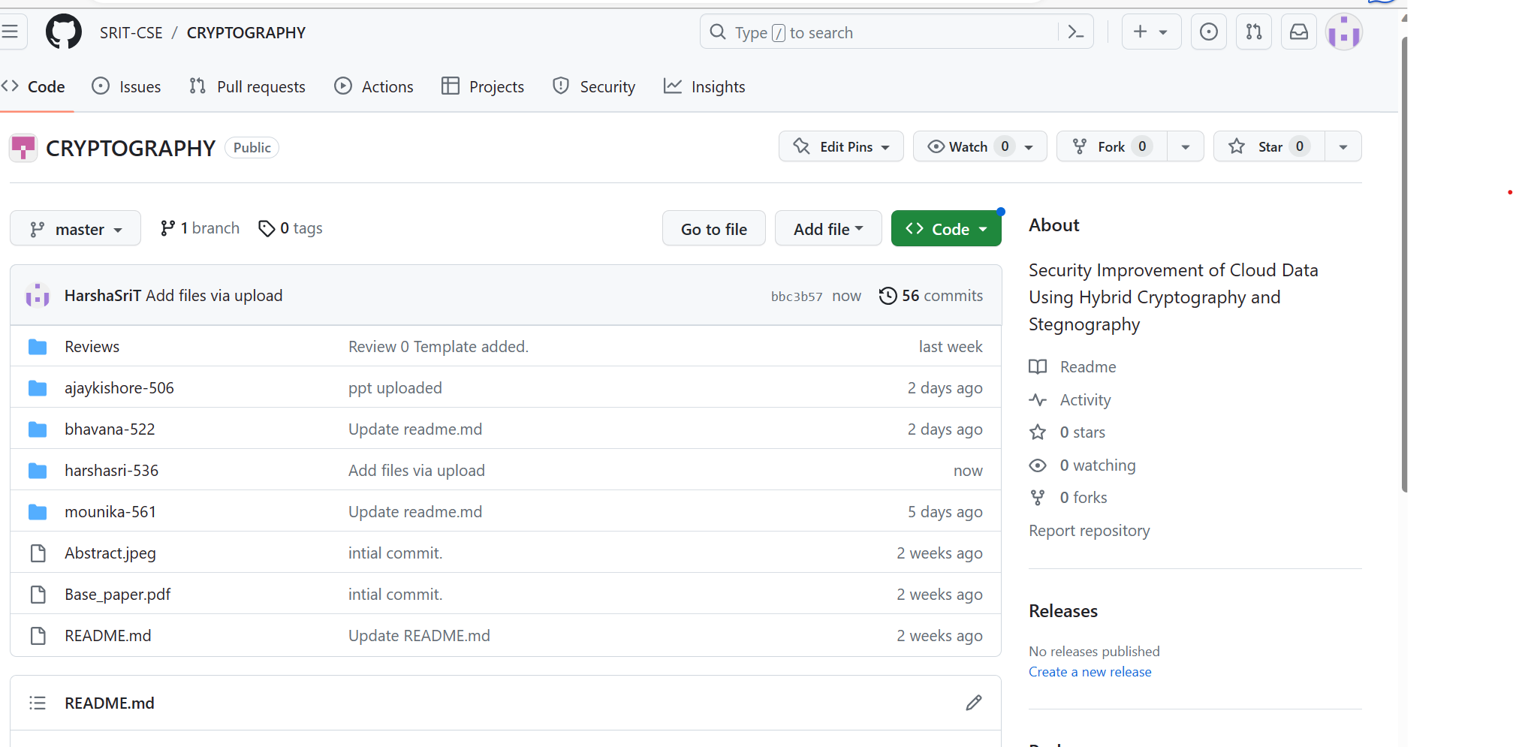
Git Hub Dashboards of each student
https://github.com/SRIT-CSE/CRYPTOGRAPHY.git

Slide 14
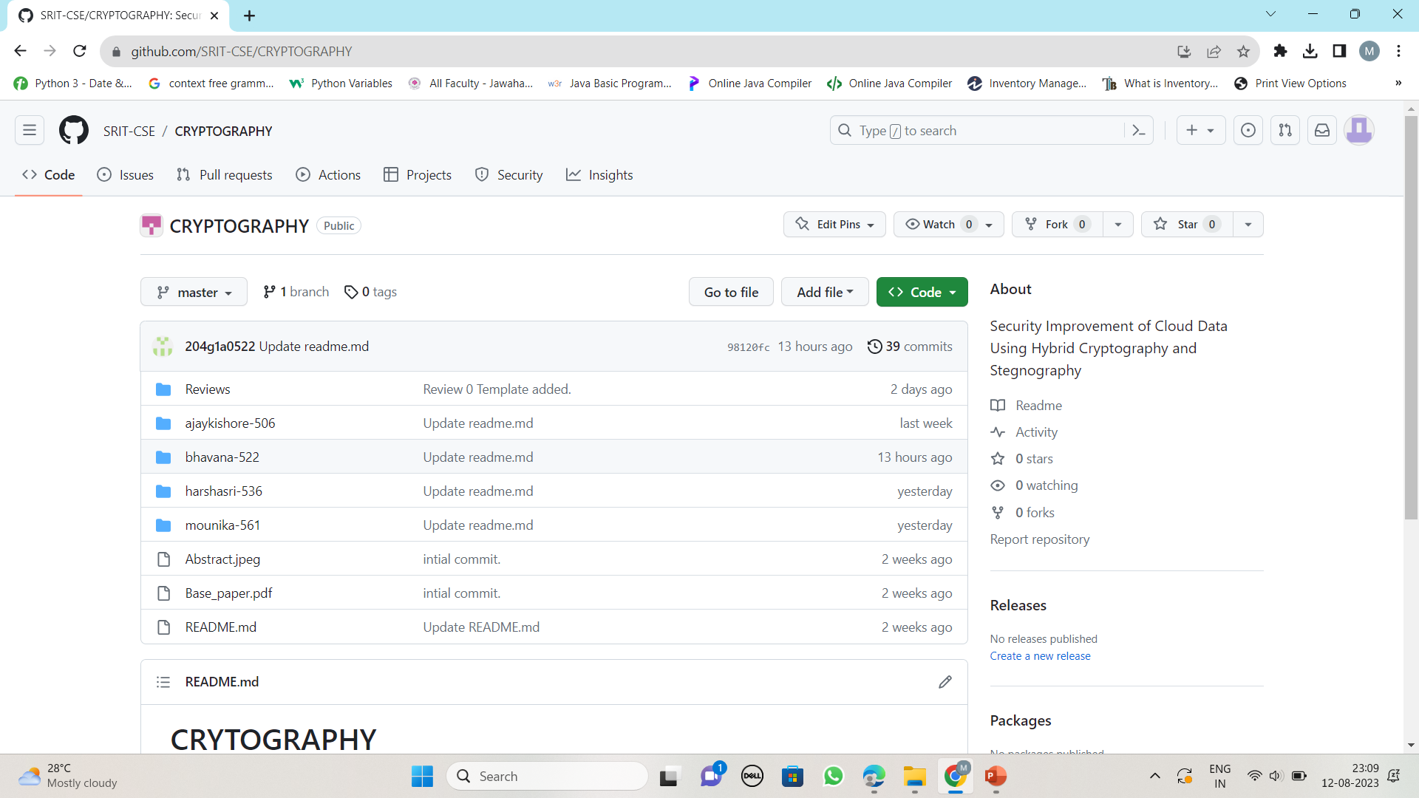
Git Hub Dashboards of each student
https://github.com/SRIT-CSE/CRYPTOGRAPHY.git

Slide 15
Any Queries?

